Slide 1
PLANNING & ORGANISING YOUR PROJECT
Dr Dave Edmondson - 16th October 2017
drdave1946@googlemail.com

Slide 2
Your projects
Each group should prepare an elevator pitch of length one minute that describes their project.
As a rough guide, speaking is at a rate of 80 – 160 words per minute so assume ~120 words is required.
Select a team leader and s/he will deliver your pitch
Notes:
I will give you up to 10 minutes to do this. If you can’t agree on someone to deliver your pitch I will randomly select a team member.

Slide 3
Successful Project management
The iron triangle
Quality
Cost
Time

Slide 4
Successful Project Management
SCOPE
Quality
Cost
Time

Slide 5
Project Life Cycle
In your project groups would you get together and determine what you would consider to be the project life cycle for a major project such as the Queensferry Crossing in Scotland.
Having done that, modify that life cycle to reflect the project life cycle for your MEng project.

Slide 6
Project life Cycle
This could represent your project life cycle
DESIGN
DEVELOPMENT
FABRICATION
OPERATION
TESTING
INTEGRATION

Slide 7
Design Phase – Major Tasks
Define goals and objectives
System level design
System requirements derived from goals and objectives
Identify major subsystems and interfaces
Concept hardware and software design
Derived from system requirements and constraints
Identify parts, costs & availability
Establish tasks, schedule, resource needs and plans for remaining phases of life-cycle
Develop preliminary risk assessment & management plan
Phase terminates with Preliminary Design Review (PDR)
NOTE: Little to no hardware testing or prototyping

Slide 8
Development Phase - 1
Test concepts by prototyping
Not building final hardware
Used to gain information necessary to refine or finalize a design
Applies to structure, electronics, sensors and software
Finalize hardware & software design
Complete system design
Define interfaces and develop appropriate Interface Control Documents (ICD)
Complete detailed design

Slide 9
Development Phase - 1
Design
Prototype
Test
Complete Design

Slide 10
Development Phase - 2
Purchase long lead items (identified at PDR)
Finalize plans for project completion
Fabrication, integration, calibration and testing
Tasks, schedule, procedures, resource needs, costs
Update risk assessment & management plan
Preliminary plan should already be in use for tracking and mitigating risks during development
Develop preliminary operational testing & data analysis plan
Phase terminate with Critical Design Review (CDR)

Slide 11
Fabrication
Flow chart
ORDER PARTS
QA / QC
ASSEMBLY
TEST
INTEGRATION

Slide 12
Fabrication
Parts procurement
Test that parts satisfy requirements before assembly
Assemble hardware & software subsystems
Fabricate component with qualified parts
If part fails initial inspection and testing, return to assembly for rework / fixing
Once complete move to integration

Slide 13
Integration
Make sure all parts fit together, if not then rework
Make sure power system is delivering
proper voltage and current
Connect electronics and sensors
Install software and run
Fix issues before proceeding
to system testing
Fit Check
Integrate
Fix
Test
System Testing

Slide 14
System Testing phase
This will obviously depend on the goals & objectives set at the start.
HOWEVER, there should be a TEST SPECIFICATION that exercises the “equipment” in such a way that the team can show that goals / objectives have been met (or not).

Slide 15
Project Execution Plan
TEAM ORGANISATION – roles & responsibilities
TEAM MANAGEMENT – majors on RISK
PROJECT PLAN – “You need to provide a suitably detailed project plan with clear milestones and deliverables.”

Slide 16
Process Flow During Life Cycle
Effort focus changes as a function of phase
Design can be highly theoretical involving simulations and calculations
Development involves “experiments” and testing concepts to gain information necessary for the design
Fabrication, Integration, and System testing requires practical skills that help to realize the design in hardware and software
Resource needs and costs changes as a function of phase
Design requires no hardware and fewer personnel
Development costs increase a bit with some prototyping
Major cost in personnel and hardware is in fabrication, integration and testing

Slide 17
Design Phase – Major Tasks
Define research question(s) and objectives
System level design
System requirements derived from goals and objectives
Identify major subsystems and interfaces
Concept hardware and software design
Derived from system requirements and constraints
Identify parts, costs & availability
Establish tasks, schedule, resource needs and plans for remaining phases of life-cycle
Develop preliminary risk assessment & management plan
Phase terminates with Preliminary Design Review (PDR)
NOTE: Little to no hardware testing or prototyping

Slide 18
Define research question(s) and objectives
RESEARCH QUESTION(S)
In your project groups using your elevator pitch, try to define your research question(s)

Slide 19
S.M.A.R.T objectives
Specific
Measurable
Attainable
Relevant
Timely
Notes:
I KEEP six honest serving-men (They taught me all I knew); Their names are What and Why and When And How and Where and Who. I send them over land and sea, I send them east and west; But after they have worked for me, I give them all a rest.

Slide 20
Your MEng project
Use your elevator pitch and your Research Question(s), in your project groups try to define a set of SMART objectives – say 5 for this project

Slide 21
Design Phase – Major Tasks
Define goals and objectives
System level design
System requirements derived from goal and objectives
Identify major subsystems and interfaces
Concept hardware and software design
Derived from system requirements and constraints
Identify parts, costs & availability
Establish tasks, schedule, resource needs and plans for remaining phases of life-cycle
Develop preliminary risk assessment & management plan
Phase terminates with Preliminary Design Review (PDR)
NOTE: Little to no hardware testing or prototyping
Notes:
I have found & will provide an example of a systems spec from a robotics student project.

Slide 22
Systems Specification – example contents
Contents
1 Introduction
1.1 Parties . . . . . . . . . . . . . . . . . . . . . . . . . . . . . . . . . . . . . . . . . . . . . . .
1.2 Purpose and goal . . . . . . . . . . . . . . . . . . . . . . . . . . . . . . . . . . . . . . . . .
1.3 Usage . . . . . . . . . . . . . . . . . . . . . . . . . . . . . . . . . . . . . . . . . . . . . . .
1.4 Background information . . . . . . . . . . . . . . . . . . . . . . . . . . . . . . . . . . . . .
1.5 Deﬁnitions . . . . . . . . . . . . . . . . . . . . . . . . . . . . . . . . . . . . . . . . . . . . .
1.6 Environmental limitations . . . . . . . . . . . . . . . . . . . . . . . . . . . . . . . . . . . . .
2 Overview of the system
2.1 Subsystems . . . . . . . . . . . . . . . . . . . . . . . . . . . . . . . . . . . . . . . . . . . .
2.1.1 Robot . . . . . . . . . . . . . . . . . . . . . . . . . . . . . . . . . . . . . . . . . . .
2.1.2 Laptop . . . . . . . . . . . . . . . . . . . . . . . . . . . . . . . . . . . . . . . . . .
2.2 Product components . . . . . . . . . . . . . . . . . . . . . . . . . . . . . . . . . . . . . . .
2.3 Dependencies on other systems . . . . . . . . . . . . . . . . . . . . . . . . . . . . . . . . .
2.4 Design philosophy . . . . . . . . . . . . . . . . . . . . . . . . . . . . . . . . . . . . . . . .
3 Software requirements
3.1 Mapping requirements . . . . . . . . . . . . . . . . . . . . . . . . . . . . . . . . . . . . . .
3.2 Trajectory planning requirements . . . . . . . . . . . . . . . . . . . . . . . . . . . . . . . .
3.3 Navigation and localization requirements . . . . . . . . . . . . . . . . . . . . . . . . . . . .
3.4 Other requirements on the software . . . . . . . . . . . . . . . . . . . . . . . . . . . . . . .
4 Robot requirements
5 Delivery and subdelivery requirements
6 Requirements regarding further development
7 Economy
8 Documentation and media

Slide 23
Design Phase – Major Tasks
Define goals and objectives
System level design
System requirements derived from goal and objectives
Identify major subsystems and interfaces
Concept hardware and software design
Derived from system requirements and constraints
Identify parts, costs & availability
Establish tasks, schedule, resource needs and plans for remaining phases of life-cycle
Develop preliminary risk assessment & management plan
Phase terminates with Preliminary Design Review (PDR)
NOTE: Little to no hardware testing or prototyping
Notes:
I have found & will provide an example of a systems spec from a robotics student project.

Slide 24
Design Phase – Major Tasks
Define goals and objectives
System level design
System requirements derived from goal and objectives
Identify major subsystems and interfaces
Concept hardware and software design
Derived from system requirements and constraints
Identify parts, costs & availability
Establish tasks, schedule, resource needs and plans for remaining phases of life-cycle
Develop preliminary risk assessment & management plan
Phase terminates with Preliminary Design Review (PDR)
NOTE: Little to no hardware testing or prototyping
Notes:
I have found & will provide an example of a systems spec from a robotics student project.

Slide 25
Breakdown
Applying Management Tools to a Project
Work
Structure
Notes:
What is a WBS?-a hierarchical description of we want to acquire/supply

Slide 26
Work Breakdown Structure (WBS)
WBS:
Defines the total system to be developed or produced.
Relate the elements of work to be accomplished to each other and to the end product.
Is displayed as a product oriented family tree composed of hardware, software, services, data and facilities which defines the total program.
Notes:
Focus on underlined words

Slide 27
Basic Purposes of Work Breakdown Structure
ORGANIZATIONAL
• Provides Structure for Assigning Multi-Disciplinary Product Teams
TECHNICAL
• Shows the System and its Subsystems as a Product Tree
• Product Tree aids:
Interface Identification & Control
Specification Development
• Provides a Structure:
Work Assignment
Material/Part Ordering
•
BUSINESS
• Provides Structure for Budgets and Cost Estimates
• Collect and Analyze Costs to track Budget
Notes:
What are the three common uses of the WBS?
It is a product of the SE process

Slide 28
The Anatomy of a WBS
A WBS has a Product Part and a Process Part.
Product part of the system
Products delivered to the operational customer.
Design (Physical) architecture.
Process part of the system
Efforts required to develop, produce and support products.
Notes:
WBS is product oriented but many WBS elements are effort related to but not directly a part of the product
We show this on later slides

Slide 29
WBS Development
Ensure all applicable work is represented.
Enough levels provided to identify work packages for control purposes. (usually levels 0,1,2)
Duplication of work eliminated.
If too few levels identified - management visibility and integration of work packages may be difficult.
If too many levels - too much time may be wasted in performing program review and control actions.
Notes:
Emphasize it is all the work
Having the right number of levels is important If too few you can’t see where the problems are, if too many it costs too much

Slide 30
WBS Levels
Level Zero- Overall System (derived from Functional level 0)
The entire project deliverable
Example: The strawberry picking system
Level One- Subsystems (derived from Functional level 1)
Major System(s)
Examples: Hardware, Software
Level Two- Components (derived from Functional level 2)
Subsystem(s): Picking “arm”, supporting structure, vision system…

Slide 31
WBS structure for YOUR project
In your groups using the material that you have already produced, start to develop your own WBS

Slide 32
Design Phase – Major Tasks
Define goals and objectives
System level design
System requirements derived from goal and objectives
Identify major subsystems and interfaces
Concept hardware and software design
Derived from system requirements and constraints
Identify parts, costs & availability
Establish tasks, schedule, resource needs and plans for remaining phases of life-cycle
Develop preliminary risk assessment & management plan
Phase terminates with Preliminary Design Review (PDR)
NOTE: Little to no hardware testing or prototyping

Slide 33
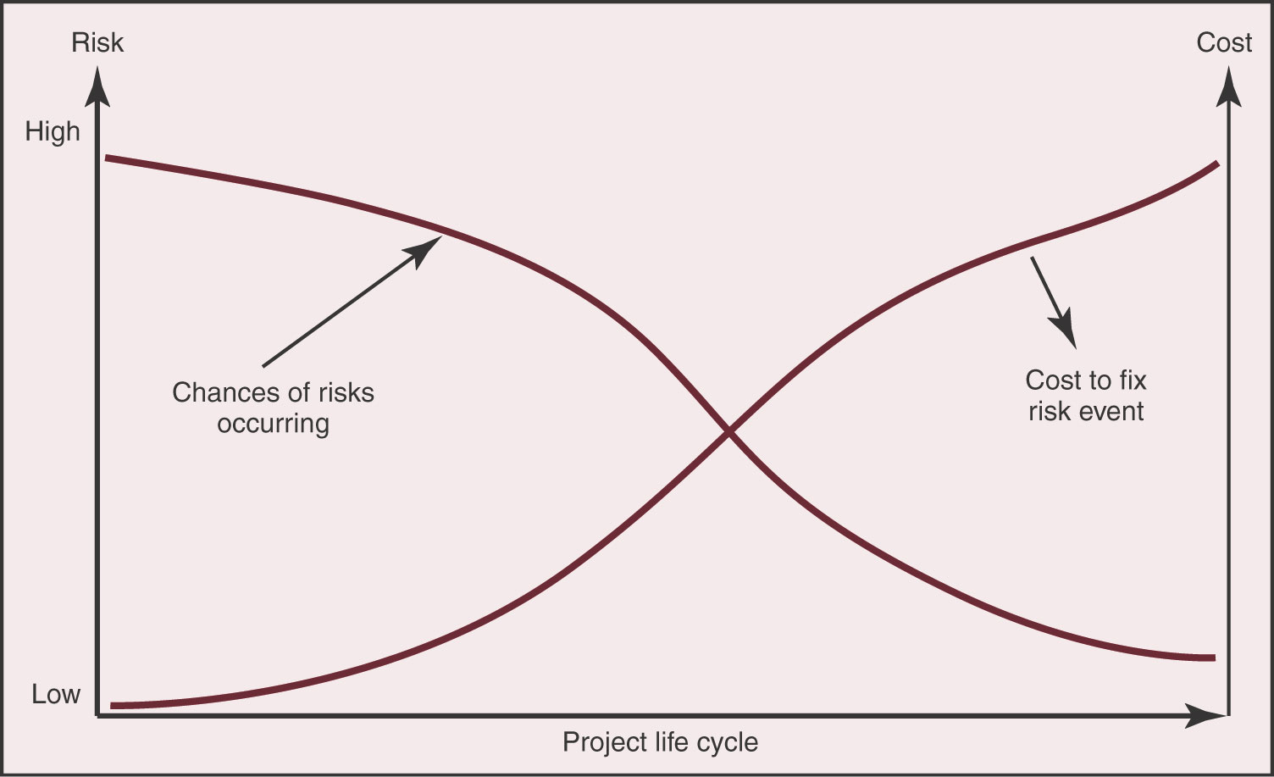
Project Risk Management

Slide 34
Project Risk Management
HIGH
PROBABILITY
LOW
HIGH
IMPACT
Notes:
To successfully implement a project, you must identify and focus your attention on middle and high-priority risks – otherwise you risk spreading your efforts too thinly, and you'll waste resources on unnecessary risk management.
With the Risk Impact/Probability Chart, you map out each risk – and its position determines its priority. High-probability/high-impact risks are the most critical, and you should put a great deal of effort into managing these. The low-probability/high-impact risks and high-probability/low-impact risks are next in priority, though you may want to adopt different strategies for each.
Low-probability/low-impact risks can often be ignored.
List all of the likely risks that your project faces. Make the list as comprehensive as possible.
Assess the probability of each risk occurring, and assign it a rating. For example, you could use a scale of 1 to 10. Assign a score of 1 when a risk is extremely unlikely to occur, and use a score of 10 when the risk is extremely likely to occur.
Estimate the impact on the project if the risk occurs. Again, do this for each and every risk on your list. Using your 1-10 scale, assign it a 1 for little impact and a 10 for a huge, catastrophic impact.
Map out the ratings on the Risk Impact/Probability Chart.
Develop a response to each risk, according to its position in the chart. Remember, risks in the bottom left corner can often be ignored, while those in the top right corner need a great deal of time and attention.

Slide 35
Project Risk Management
There are known knowns. These are things we know that we know. There are known unknowns. That is to say, there are things that we know we don't know. But there are also unknown unknowns. There are things we don't know we don't know.
Donald Rumsfeld
Notes:
This has led me classify unknowns into one of the following two types: 1. known unknowns (expected or foreseeable conditions), which can be reasonably anticipated but not quantified based on past experience as exemplified by case histories (in Appendix A and 2). Unknown unknowns (unexpected or unforeseeable conditions), which pose a potentially greater risk simply because they cannot be anticipated based on past experience or investigation.
Known unknowns result from phenomena which are recognized, but poorly understood. On the other hand, unknown unknowns are phenomena which cannot be expected because there has been no prior experience or theoretical basis for expecting the phenomena.

Slide 36
Project Risk Management
Known unknowns (expected or foreseeable conditions), which can be reasonably anticipated but not quantified based on past experience as exemplified by case histories
Unknown unknowns (unexpected or unforeseeable conditions), which pose a potentially greater risk simply because they cannot be anticipated based on past experience or investigation.
Notes:
Known unknown – example - key component has been ordered on the basis of 6 week delivery you are now told that it will be 12 weeks.
Unknown unknown – example – Plymouth U campus completely destroyed.

Slide 37
CONFLICT TYPES
CONFLICT RESOLUTION STYLES
This is a questionnaire on conflict resolution
Listen to the instructions CAREFULLY & complete the questionnaire as instructed
Robert C Benfari: Understanding and Changing Your Management Style.

Slide 38
CONFLICT TYPES
DIRECTION CONFLICTS
Ask yourself, “Am I clear on the direction or vision?”
Clarify the discrepancy so that it can be easily described in neutral words & take action.
Ask permission to address the discrepancy with the other person in a friendly way and gain agreement.
If there is a difference in values, always go with the higher value.
Make authentic comments.

Slide 39
CONFLICT TYPES
ROLE CONFLICTS
Ask yourself, “Exactly how do I perceive my role in relation to others involved in this issue?”
Take responsibility for clarifying your role with others involved.
Be prepared to change the perception of your role.
Show your willingness to be flexible in achieving your organization’s goals.
Stay positive. View any change in role in terms of the opportunities that it presents.

Slide 40
CONFLICT TYPES
PROCESS CONFLICTS
Ask yourself, “How much control do I have over this process conflict?”
Identify the root cause of the problem and analyze the improvement opportunity.
Talk first to the owner of the process.
Describe the current problem and get agreement.
Suggest a workable solution and action plan.
Follow-through on the plan and give recognition to the owner of the process.

Slide 41
CONFLICT TYPES
INTERPERSONAL CONFLICTS
Ask yourself, ”How much do my personal biases & prejudices effect this relationship?”
Write down three behaviours that you could change in order to reduce the conflict in this relationship.
Ask the other person involved how you could defuse the existing conflict.
Put yourself in their position. How do you think they view your commitment to reducing conflict?
Make a list of 5 strengths that you see in the other person. Then list 5 ways that improving this relationship would benefit you.

Slide 42
CONFLICT TYPES
DIRECTION CONFLICTS
Ask yourself, “Am I clear on the direction or vision?”
Clarify the discrepancy so that it can be easily described in neutral words & take action.
Ask permission to address the discrepancy with the other person in a friendly way and gain agreement.
If there is a difference in values, always go with the higher value.
Make authentic comments.

Slide 43
CONFLICT TYPES
EXTERNAL CONFLICTS
Ask yourself, “How much control do I have over this factor?”
Chose to fight battles that are worth the price.
Put your energy into things that you “can do” rather than complain about things that you “can’t do”.
Do something good for others.
Maintain perspective and sense of purpose.
Talk to someone you trust.

Slide 44
PLANNING A PROJECT
This exercise is designed to take all of you out of your comfort zone
As a group you will need to think about the precise circumstances within which you are being asked to plan.

